Slide 1


AI Project Presentation
2
+
2
+
CS-026 ♢ CS-031 ♢CS-307
Syed Muhammad Asad Hafiz M. Saad Waqar
Bilal Shamim
COURSE INSTUCTOR: DR. SAAD QASIM
1

Slide 2

STUDENT PERFORMANCE PREDICTOR
2
+
Using Linear Regression
STUDENT PERFORMANCE PREDICTOR
2

Slide 3

OUTLINE
Problem Definition and its Solution.
Language, Algorithm and Framework used.
Data Set.
GPA Histogram.
Linear Regression (An Overview).
Implementation and Summary the Algorithm.
Satter Plot.
Why Linear Regression???
GPA vs Course Plot, Mean Line Plot.
Residual vs Fitted Values Plot, Normal QQ Plot.
Scale-Location Plot, Best Fitted Line Plot.
Conclusion.
3

Slide 4

Problem Definition
2
+
2
+
Weak Students not be able to have extra attention by the teachers.
STUDENT PERFORMANCE PREDICTOR
4

Slide 5

The Solution
2
+
2
+
ACADEMIC PERFORAMCE PREDICTOR
5

Slide 6

LANGUAGE
2
+
2
+
FRAMEWORK
2
+
2
+
R
RSTUDIO
2
+
ALGORITHM
2
+
Linear Regression
6

Slide 7
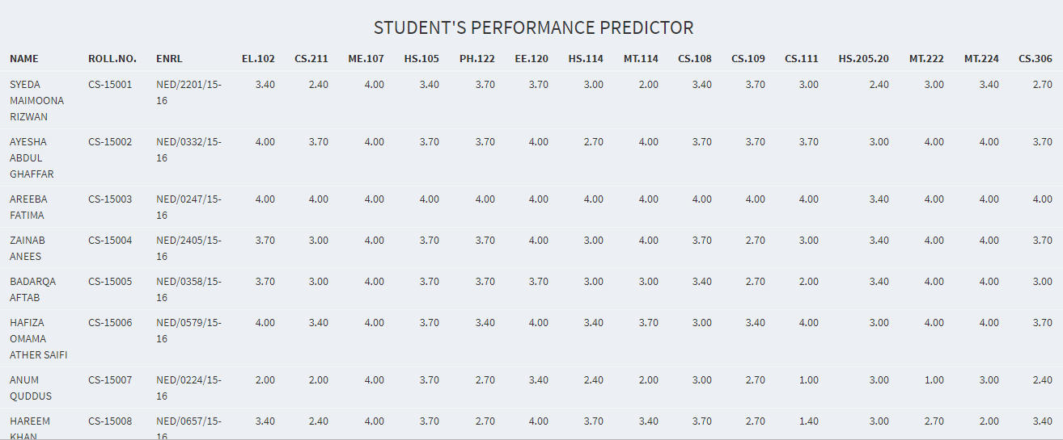
DATASET
The dataset that we have used in this project is CIS Department’s Final Year students of NED University of Engineering and Technology.
This dataset contains course wise GPA of every student with their CGPAs per semester.
7

Slide 8

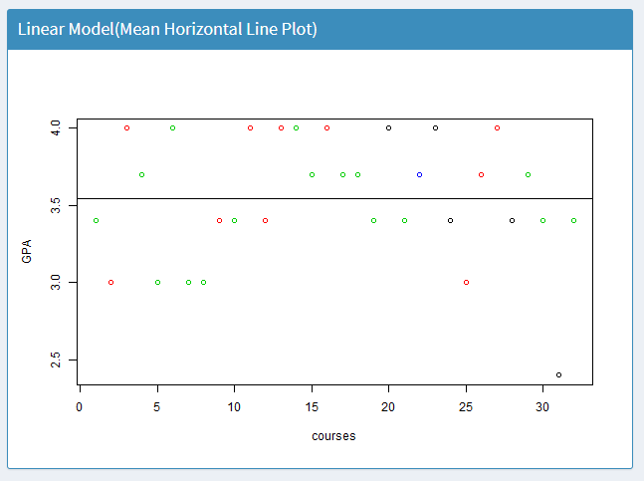
LINEAR REGRESSION - Line of best fit
2
+
An Overview of the algorithm
2
+
linear regression is a type of regression analysis where the number of independent variables is one and there is a linear relationship between the independent(x) and dependent(y) variable. The line in the graph is referred to as the best fit straight line. Based on the given data points, we try to plot a line that models the points the best. The line can be modelled based on the linear equation shown below.
Y = MX + C
The motive of the linear regression algorithm is to find the best values for C(intercept) and M(slope). Before moving on to the algorithm, let’s have a look at two important concepts you must know to better understand linear regression
8

Slide 9
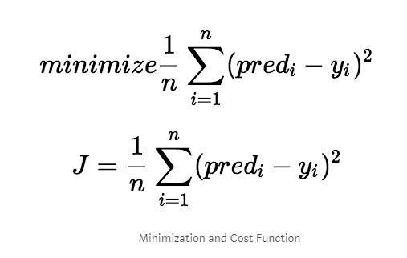
LINEAR REGRESSION
2
+
COST FUNCTION
continued
2
+
The cost function helps us to figure out the best possible values for C(intercept) and M(slope) which would provide the best fit line for the data points. Since we want the best values for C and M, we convert this search problem into a minimization problem where we would like to minimize the error between the predicted value and the actual value.
9

Slide 10
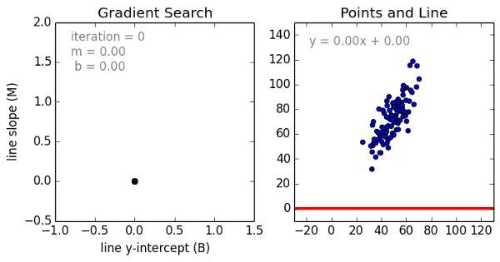
LINEAR REGRESSION
2
+
Gradient Descent
2
+
continued
Gradient descent is a method of updating C and M to reduce the cost function (MSE). The idea is that we start with some values for C and M and then we change these values iteratively to reduce the cost. Gradient descent helps us on how to change the values.
10

Slide 11
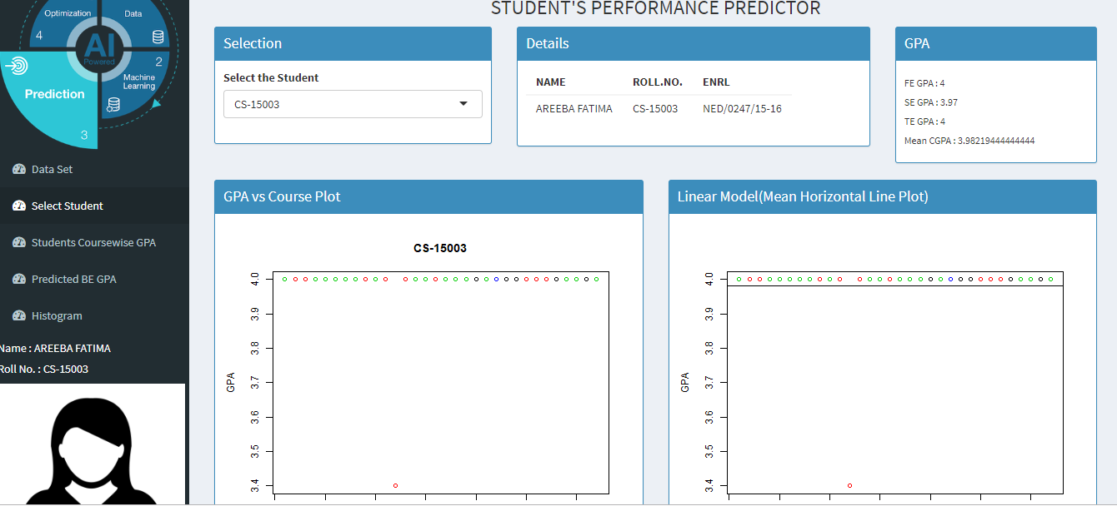
2
+
2
+
APPLING LINEAR REGRESSION ON OUR PROJECT.
11

Slide 12
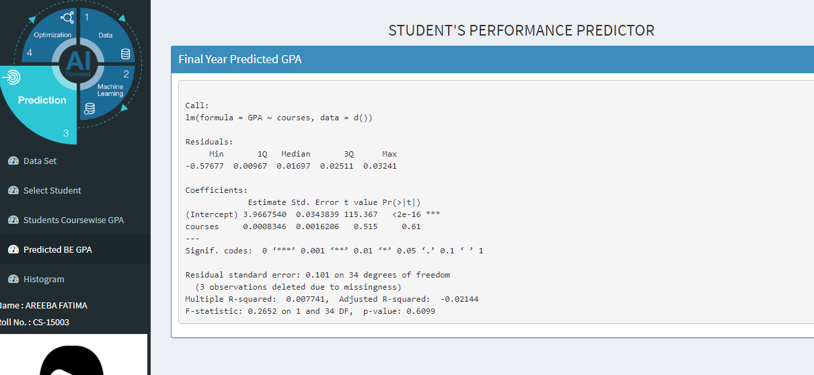
Predicted GPA
ERROR
2
+
2
+
SUMMARY OF THE ALGORITHM.
12

Slide 13
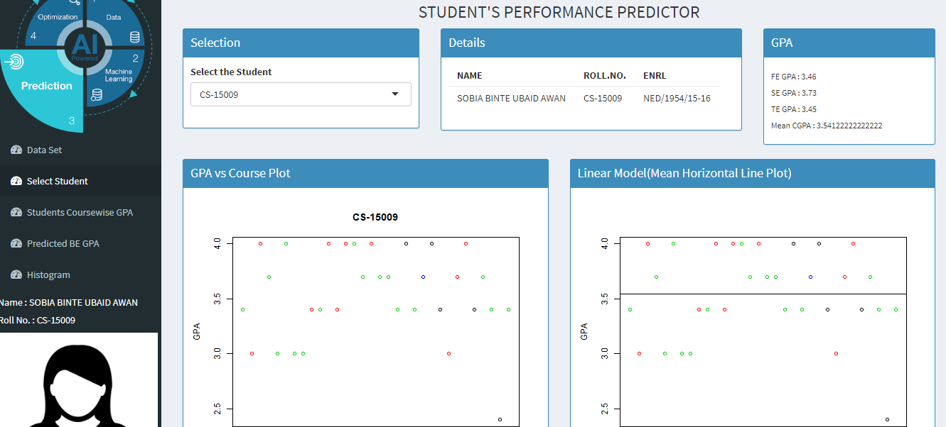
2
+
2
+
SCATTERED PLOT
13

Slide 14
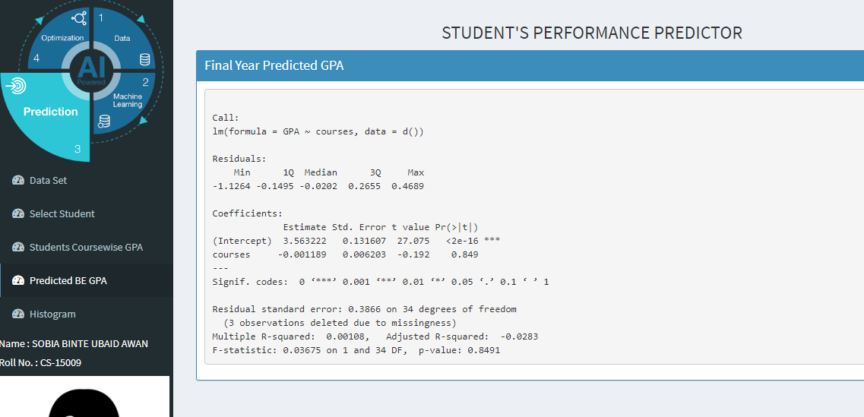
Predicted GPA
ERROR
2
+
2
+
SUMMARY OF THE ALGORITHM.
14

Slide 15

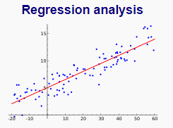
2
+
WHY LINEAR REGRESSION???
2
+
BECAUSE
Linear regression is a linear approach to modelling the relationship between a scalar response (or dependent variable) .
Here GPA is dependent on courses.
15

Slide 16

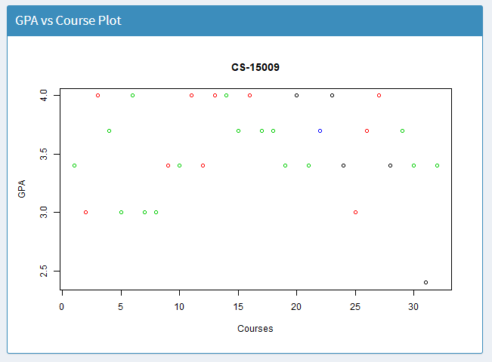
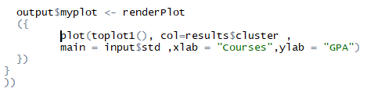
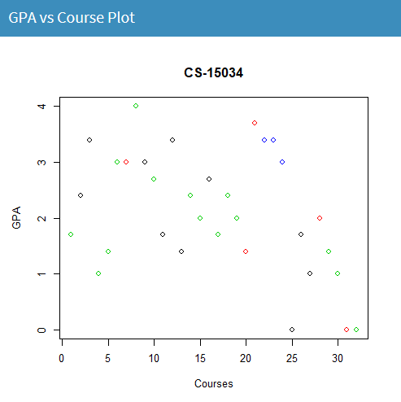
GPA vs course PLOT
R CODE
16

Slide 17

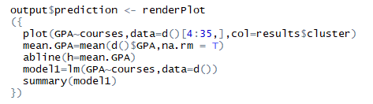
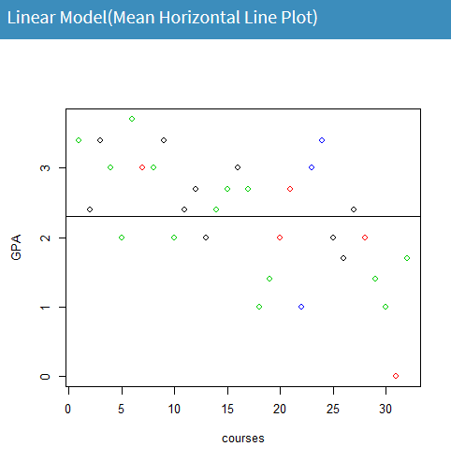
LINEAR MODEL (MEAN HORIZONTAL LINE PLOT)
R CODE
17

Slide 18
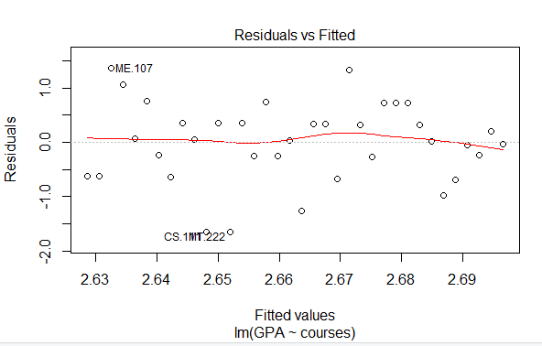
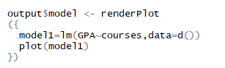
WHAT IS A RESIDUAL? A residual is the difference between the observed value of the dependent variable (y) and the predicted value (ŷ).
RESIDUAL VS FITTED VALUES PLOT
This plot tests the assumptions of whether the relationship between your variables is linear (i.e. linearity) and the whether there is equal variance along the regression line.
A “good” residuals vs. fitted plot should be relatively shapeless without clear patterns in the data, no obvious outliers.
RCODE:
18

Slide 19
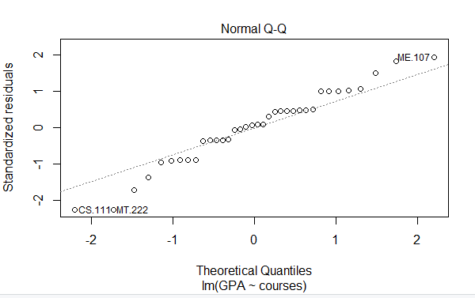
NORMAL Q-Q PLOT
The normal qq plot helps us determine if our dependent variable is normally distributed by plotting quantiles (i.e. percentiles) from our distribution against a theoretical distribution.
If our data is normally distributed, it will be plotted in a generally straight line on the qq plot.
19

Slide 20

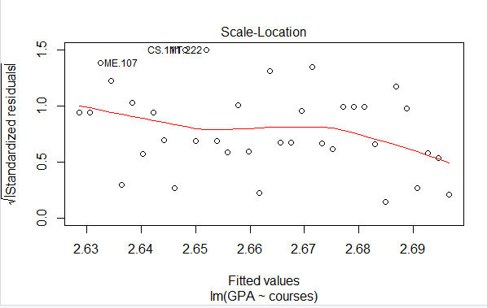
Scale-Location Plot
The Scale-Location plot shows whether our residuals are spread equally along the predictor range, i.e. homoscedastic. We want the line on this plot to be horizontal with randomly spread points on the plot.
20

Slide 21
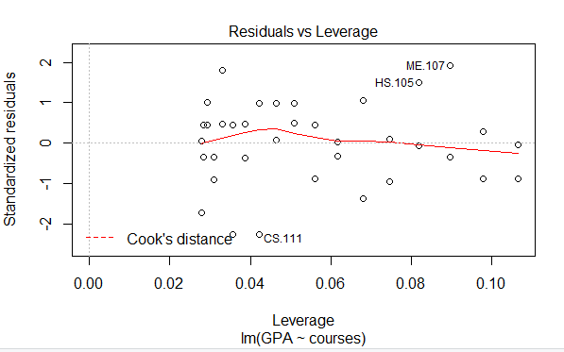
Residuals vs leverage PLOT
COOK’S DISTANCE
Cook's distance measures the effect of deleting a given observation. Points with a large Cook's distance are considered to merit closer examination in the analysis.
The Residuals vs. Leverage plots helps you identify influential data points on your model. Outliers can be influential, though they don’t necessarily have to it and some points within a normal range in your model could be very influential.
The points we’re looking for(or not looking for) are values in the upper right or lower right corners, which are outside the red dashed Cook’s distance line. These are points that would be influential in the model and removing them would likely noticeably alter the regression results.
21

Slide 22
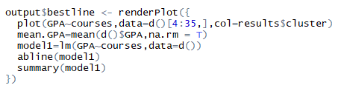
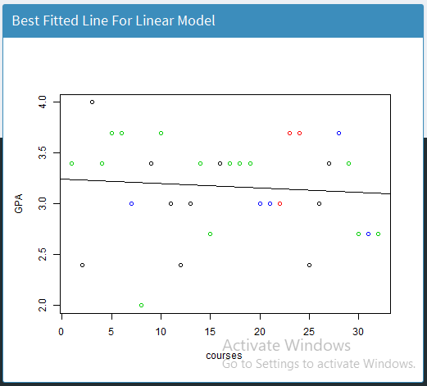
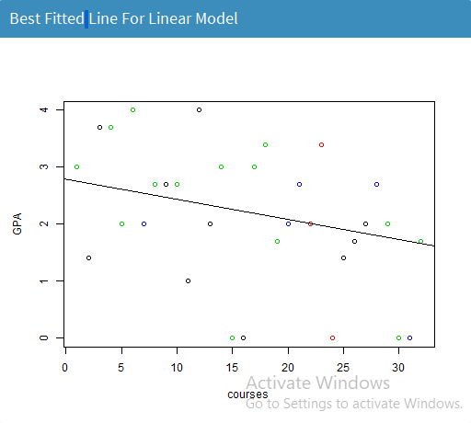
BEST FITTED LINE PLOT
R CODE
22

Slide 23
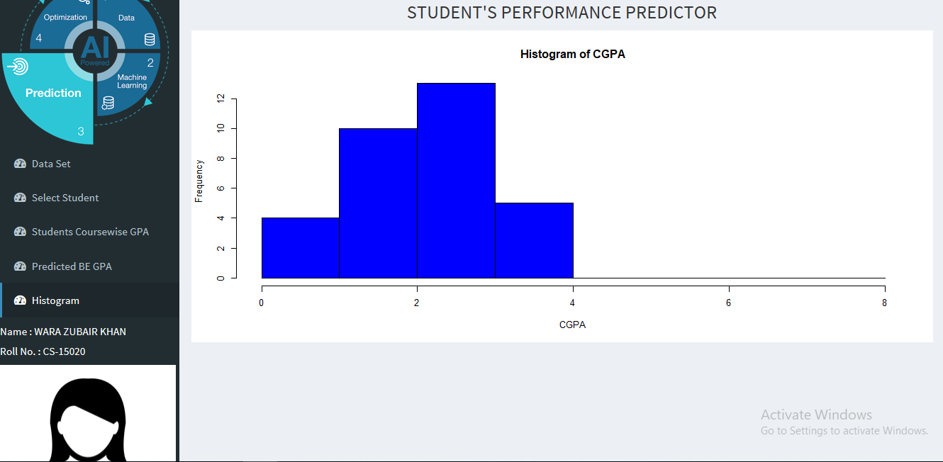
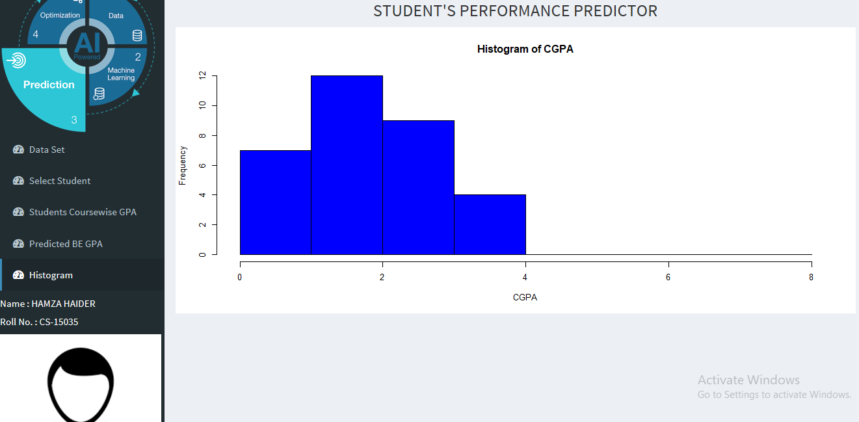
2
+
GPA
HISTOGRAMS
2
+
23

Slide 24

THANK YOU!
2
+
You can come to us if you want to predict your GPA too.. ☺
24

